Slide 1








Crocodile Club
AFTER SCHOOL CHILDCARE

Slide 2









About Crocodile Club
Crocodile Club is registered with Ofsted (Registration No 110667) and is based in Stockcross School. The club opens at 3.15pm until 5.45 pm Monday, Tuesday, Wednesday & Thursday, during term time. We welcome children from Stockcross Primary and Welford & Wickham School.

Slide 3


At Croc Club we aim to provide a safe, secure and relaxed environment, offering a range of activities to reflect the interests of the children in our care.
Our Club follows the Play work Principles: children are free to choose activities and resources as they wish, including dressing up, home corner, craft, board games, construction, physical play and reading. In addition, other resources are available for the children to select from our equipment library.
We cook, explore and create.

Slide 4
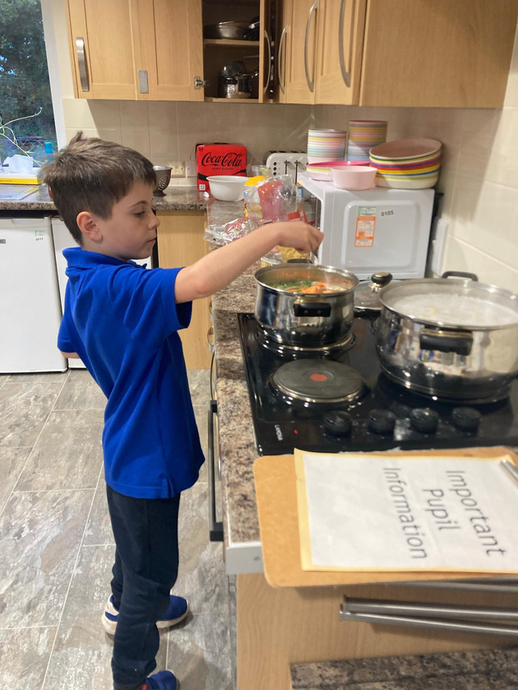
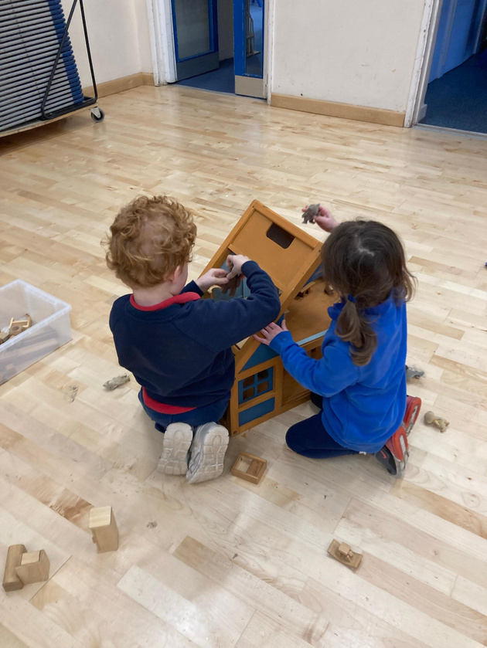

We offer..
• A large outside space including adventure playground.
• A health snack
• Well trained, qualified experienced staff
• Happy and content children
• A highly rated Ofsted childcare provider (January 2024)
• A large amount of resources for your child
• Transportation from Welford and Wickham to Stockcross School
. A key member of staff for each EYFS Child

Slide 5
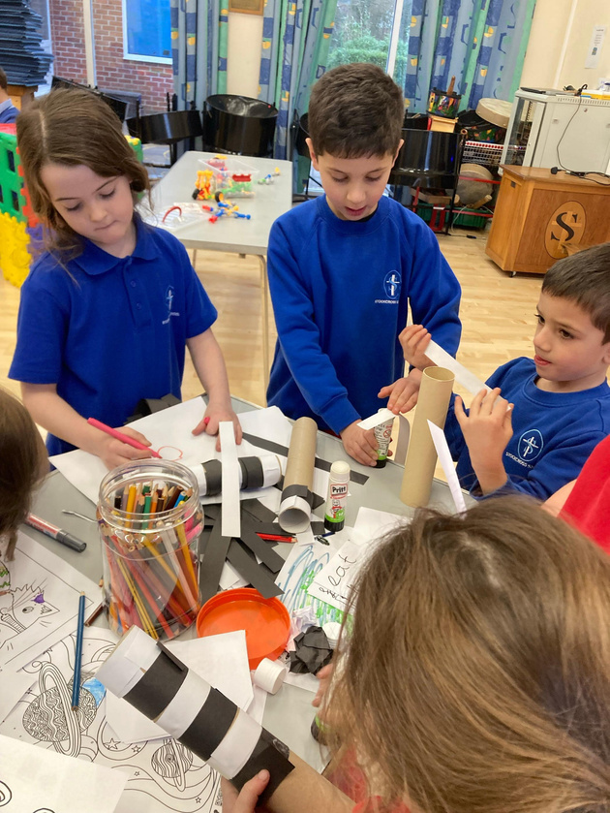
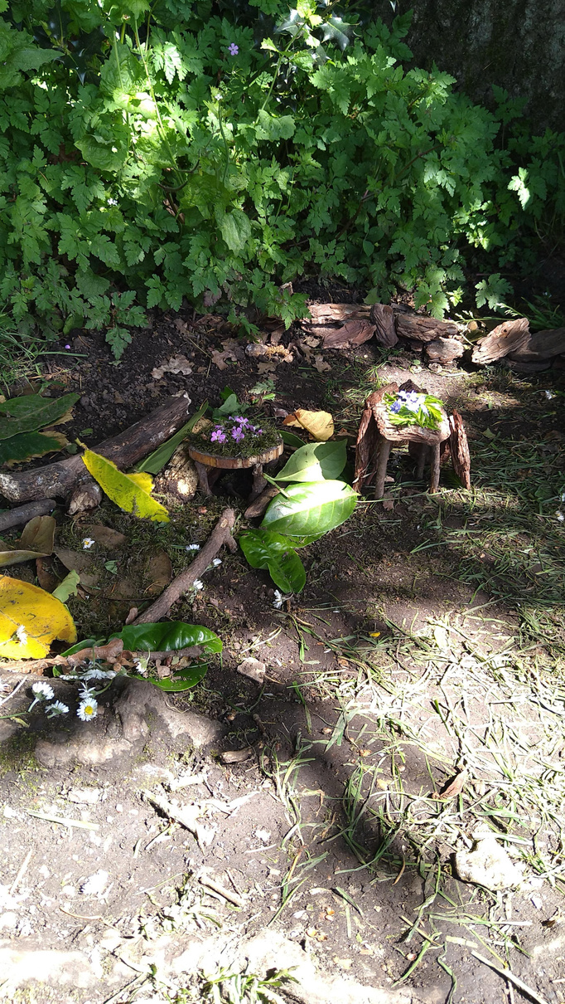
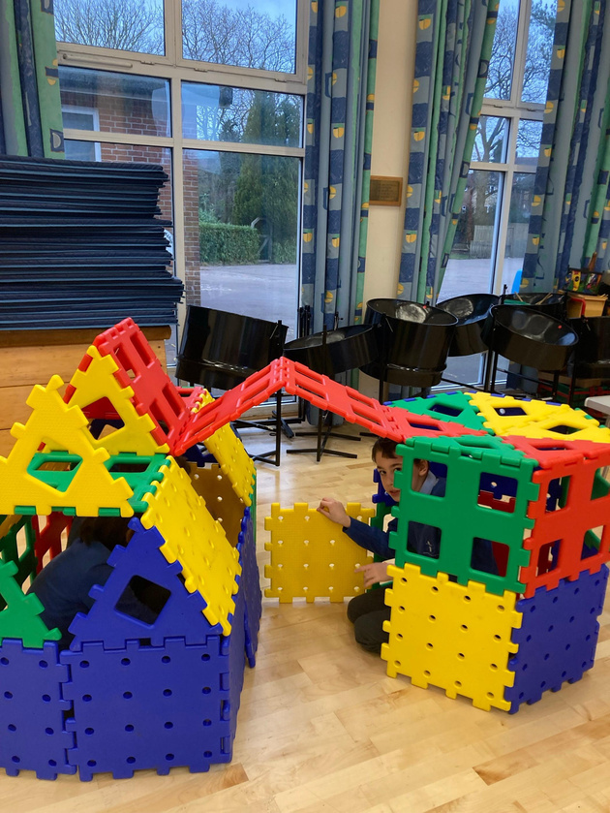
Payment of fees
The current fees are £13.75 per session. Sessions are booked termly. Crocodile Club does not operate a “drop in” system. Fees are payable in advance by cash or cheque, bank transfer, Tax-Free Childcare or childcare vouchers.
We accept vouchers from childcare voucher schemes, the club manager can help with this.

Slide 6

Our Pledge to You
We value our relationship with parents/carers and are committed to working in partnership with you to provide top quality play and care for your children. We will:
  Welcome you at all times to discuss our work, have a chat or take part in our activities.
  Keep you informed of opening times, fees and charges, programmes of activities, menus, and procedures.
  Be consistent and reliable to enable you to plan with confidence and peace of mind.
  Share and discuss your child's achievements, experiences, progress, and friendships.
  Be available to discuss decisions about running the club.
  Ask your permission for outings and special events.
  Listen to your views and concerns to ensure that we continue to meet your needs.

Slide 7


FOR MORE INFORMATION VISIT:
www.welfordandwickhamprimaryschool.org
WWW.stockcrossprimaryschool.org
OR CONTACT
SARAH BEGLEY- CLUB MANAGER FOR YOUR ADMINISTRATION, BOOKING AND BILLING ENQUIRIES
EMAIL: CROCFINANCE@STOCKCROSS.ORG.UK
LIZ ENGLISH- CLUB CHAIRPERSON, GENERAL ENQUIRIES
EMAIL: CROCINFO@STOCKCROSS.ORG.UK
TELEPHONE: 01488608356

